Slide 1
Component Rendering and Side Effects

Slide 2
Rendering !== Updating the browser

Slide 3
When the state of a component changes it re-renders

Slide 4
React element
tr
React element
tr
React element
td
React element
td
React element
td
React element
td
React element
tr
React element
tr
React element
td
React element
td
React element
td
React element
td
React element
tr
React element
td
React element
td

Slide 5
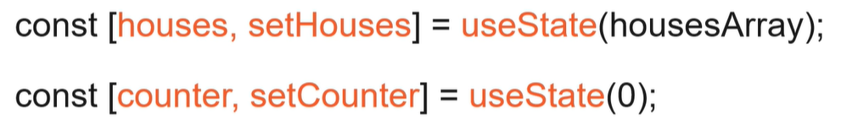
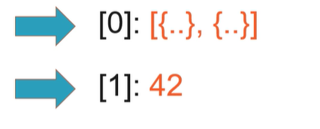
How React Keeps State

Slide 6
The Rendering Process
App
Banner
HouseList
HouseRow
HouseRow
HouseRow

Slide 7

The Rendering Process
App
Banner
HouseList
HouseRow
HouseRow
HouseRow

Slide 8
The Rendering Process
App
Banner
HouseList
HouseRow
HouseRow
HouseRow

Slide 9
The Rendering Process
App
Banner
HouseList
HouseRow
HouseRow
HouseRow

Slide 10
The Rendering Process
App
Banner
HouseList
HouseRow
HouseRow
HouseRow

Slide 11
Cascading effect
Doesn't degrade performance in a well designed application
Remember reconciliation
Something to always keep in mind when designing the application
State Changes and Re-Renders

Slide 12
A Pure Function
const returnNumber = () => 42;

Slide 13
Another Pure Function
const add = (a, b) => a + b;

Slide 14
Easy to test
Predictable
Reliable Cacheable
Pure Functions
Function components must be pure

Slide 15
When it's faster
Measure
When to Use React.memo
Pure functional component
Renders often
With the same prop values JSX isn't trivial

Slide 16
https://reactjs.org/docs/ react-api.html#reactmemo

Slide 17
Unpredictable operations in components should be set aside

Slide 18
(Side) effects

Slide 19
API interaction
Use browser APIs (e.g. document, window) Using timing functions (e.g. setTimeout)
Effect Examples

Slide 20
The Effect Hook
useEffect(() => {
//perform the effect
});

Slide 21
Effect Hook: Dependency Array
const [ counter, setCounter ] = useState(0);
useEffect(() => { document.title = counter;
});

Slide 22
Effect Hook: Dependency Array
const [ counter, setCounter ] = useState(0);
useEffect(() => { document.title = counter;
}, [ counter ]);

Slide 23
Optional exercise:
Persist the new house and extract the add button into a new component

Slide 24
Effect Hook: Separation of Concerns
useEffect(() => { document.title = counter;
}, [ counter ]);
useEffect(() => {
//fetch from API
}, [ ]);

Slide 25
Effect Hook: Cleaning Up
useEffect(() => {
//subscribe return () => {
//unsubscribe
};
}, [ ]);

Slide 26
Coming up:
The Memo and Ref hooks

Slide 27
Memo hook: Memoize values in components

Slide 28
The Memo Hook
const result = timeConsumingCalculation(houses)
;

Slide 29
The Memo Hook
const result = useMemo(() => { return
timeConsumingCalculation(houses);
}, [ houses ]);

Slide 30
Ref hook:
Persist values that survive re-renders without causing a re-render

Slide 31
The Ref Hook
const TextInputWithFocusButton = () => { const inputEl = useRef(null);
const onButtonClick = () => inputEl.current.focus(); return (
<>
<input ref={ inputEl } type="text" />
<button onClick={ onButtonClick }>Focus the input</button>
</>
);
};

Slide 32
Next up:
Conditional Rendering and Shared State

